Slide 1

Wecare Hospital
Apoorva Mishra

Slide 2

CONTENTS
Summary - System Workflow
E-R Diagram
Database TABLES
Database Objects
DEMO of the Graphical User Interface (GUI) created (optional)
Dashboard

Slide 3

SUMMARY
The database is created to manage and address the appointments at a multi-location hospital. It will cater and support the following:
Scheduling appointments for patients
Managing diagnosis, treatment, prescription and invoice related information
Tracking information for the visits of the patients
Storing and managing medical details of the patient
Handling equipment and supplies information

Slide 4

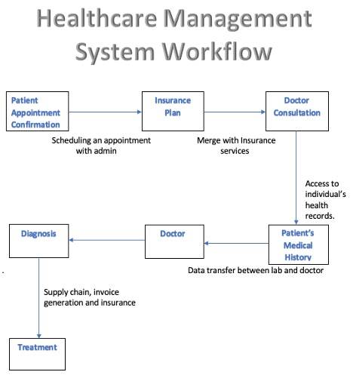

Slide 5
E-R Diagram

Slide 6
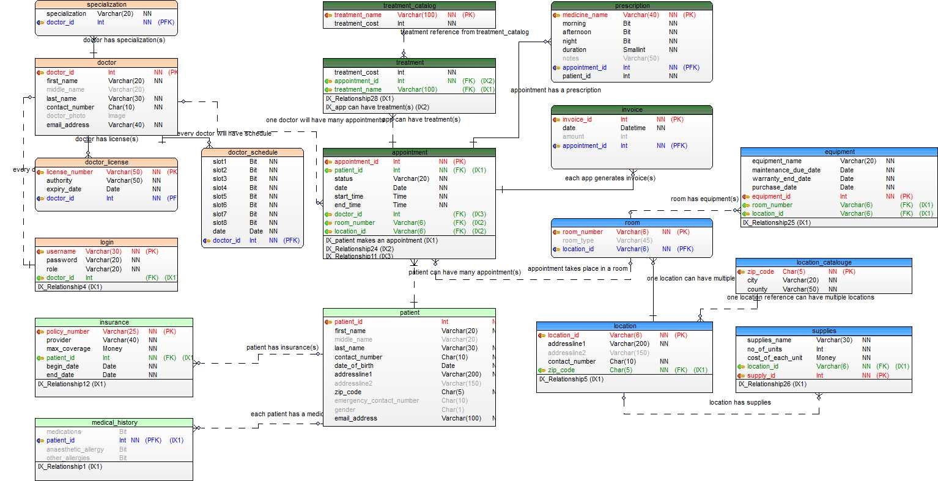

Slide 7
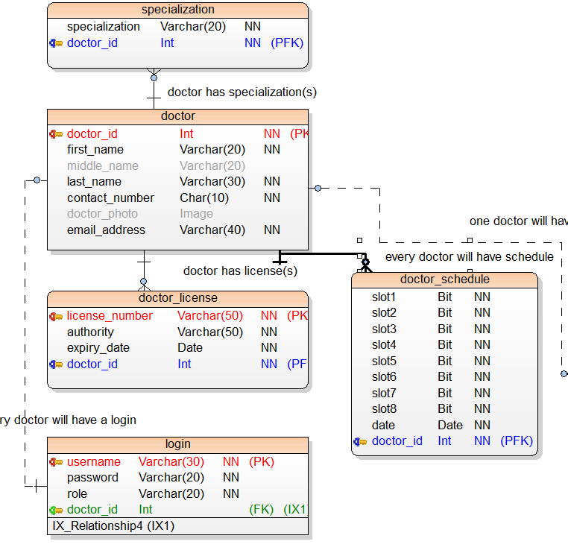
CLUSTER: Provider

Slide 8
Doctor Entity
In this cluster the key entity will be the doctor.
The doctor’s details on license and specialization are stored in the database and it is managed by the admin/doctors.
All doctors have login credentials to the database where they can schedule, track and manage all the appointments of their patients.
During the consultation, doctor prescribes medication through prescriptions and decides whether or not person requires an additional treatment.

Slide 9
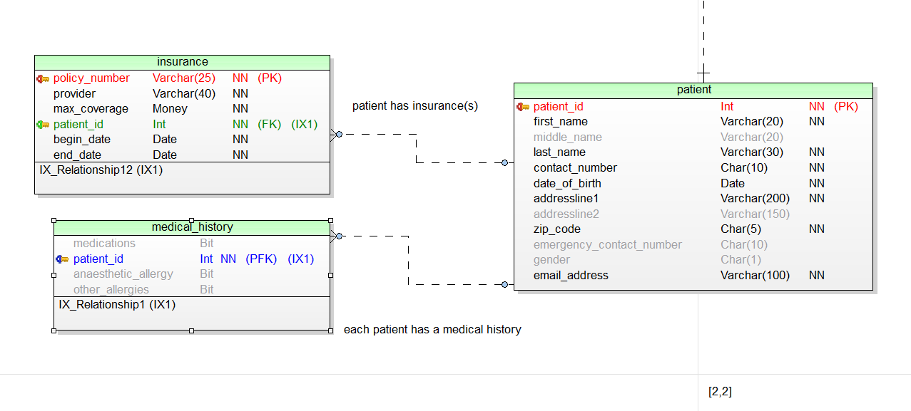
CLUSTER: Receiver

Slide 10
Patient Entity
Following the consultation, doctor prescribes any medication or treatment.
All this data is stored in the patient’s medical records.
Medical records or history contains information about previous consultations of a patient, which can be used to diagnose patients with any long history of diseases or allergies.
Medical history plays a crucial role in treating a patient.
The treated patient can then claim their insurance based on the type of treatment, if it qualifies for any insurance scheme.
The insurance coverage varies with companies for each treatment.

Slide 11
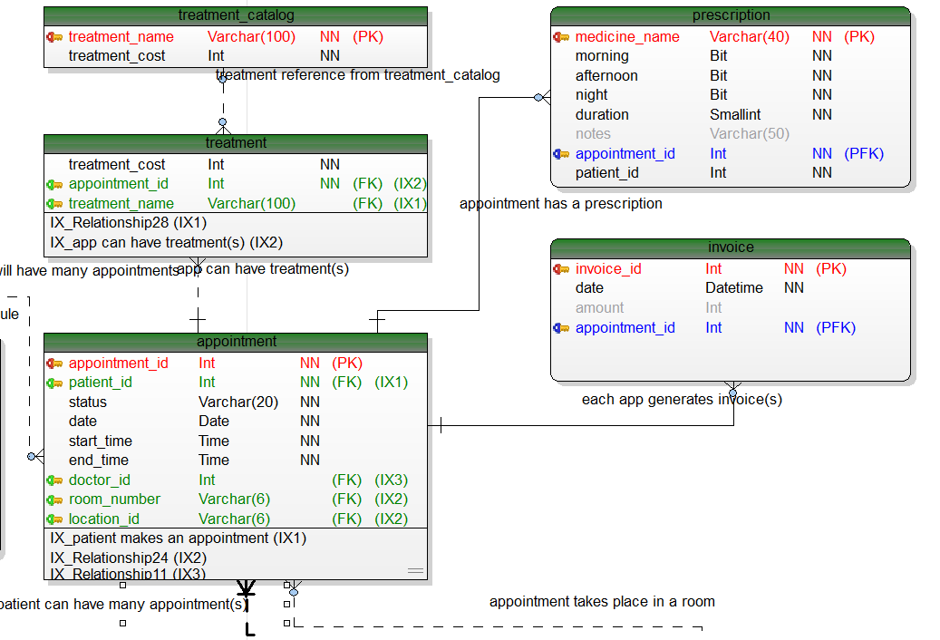
CLUSTER: Appointment

Slide 12
Appointment Entity
Appointment is the key entity of this cluster and it is the primary key here.
Once an appointment is given to a patient the following happens:
Doctor is assigned
Prescription is given- Can be in the form of treatment or medication
Treatment can be selected from treatment catalogue entity
Invoice is generated based on the consultation with the doctor

Slide 13
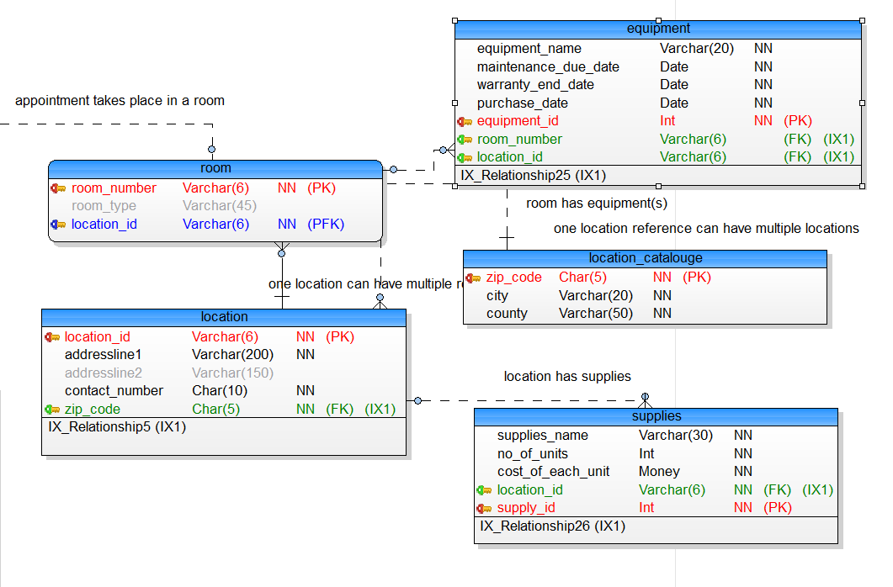
CLUSTER: Location

Slide 14
Location Entity
Hospitals can have many branches and can be spread across a region which can be tracked by the attributes in the location entity.
Every hospital has certain standard requirements such as rooms for the patients, equipment to facilitate treatments and medical supplies.
“Supplies” entity demonstrates the required quantity, cost and details of the supplier.
“Equipment” entity entails every detail about the equipment such as name, warranty date, maintenance date, room number, location etc., for every room at every hospital.

Slide 15
DATABASE TABLES

Slide 16
.
PATIENT
MEDICAL HISTORY
CREATE TABLE [patient]
(
[patient_id] Int IDENTITY NOT NULL,
[first_name] Varchar(20) NOT NULL,
[middle_name] Varchar(20) NULL,
[last_name] Varchar(30) NOT NULL,
[contact_number] Char(10) NOT NULL,
[date_of_birth] Date NOT NULL,
[addressline1] Varchar(200) NOT NULL,
[addressline2] Varchar(150) NULL,
[zip_code] Char(5) NOT NULL,
[emergency_contact_number] Char(10) NULL,
[gender] Char(1) NULL,
[email_address] Varchar(100) NOT NULL
CONSTRAINT [PK_patient] PRIMARY KEY ([patient_id]))
Go
ALTER TABLE [dbo].[patient] WITH CHECK ADD CHECK (([gender]='M' OR [gender]='F’))
ALTER TABLE [dbo].[patient] WITH CHECK ADD CHECK (([zip_code] like '[0-9][0-9][0-9][0-9][0-9]'))
CREATE TABLE [medical_history]
(
[medications] Bit NULL,
[patient_id] Int NOT NULL,
[anaesthetic_allergy] Bit NULL,
[other_allergies] Bit NULL
CONSTRAINT [PK_medical_history] PRIMARY KEY ([patient_id]))
go

Slide 17
.
APPOINTMENT
CREATE TABLE [appointment]
(
[appointment_id] Int IDENTITY NOT NULL,
[patient_id] Int NOT NULL,
[status] Varchar(20) NOT NULL,
[date] Date NOT NULL,
[start_time] Time NOT NULL,
[end_time] Time NOT NULL,
[doctor_id] Int NULL,
[room_number] Varchar(6) NULL,
[location_id] Varchar(6) NULL
CONSTRAINT [PK_appointment] PRIMARY KEY ([appointment_id]))
go
CREATE INDEX [IX_patient makes an appointment] ON [appointment] ([patient_id])
go
CREATE INDEX [IX_roomno] ON [appointment] ([room_number],[location_id])
go
CREATE INDEX [IX_doctorschedule] ON [appointment] ([doctor_id])
Go
INSUARANCE
CREATE TABLE [insurance]
(
[policy_number] Varchar(25) NOT NULL,
[provider] Varchar(40) NOT NULL,
[max_coverage] Money NOT NULL,
[patient_id] Int NOT NULL,
[begin_date] Date NOT NULL,
[end_date] Date NOT NULL
CONSTRAINT [PK_insurance] PRIMARY KEY ([policy_number]))
go

Slide 18
.
TREATMENT CATALOG
TREATMENT
CREATE TABLE [treatment_catalog]
(
[treatment_name] Varchar(100) NOT NULL,
[treatment_cost] Int NOT NULL
CONSTRAINT [PK_treatment_catalog] PRIMARY KEY ([treatment_name]))
go
CREATE TABLE [treatment]
(
[treatment_cost] Int NOT NULL,
[appointment_id] Int NOT NULL,
[treatment_name] Varchar(100) NULL
)
go
CREATE INDEX [IX_treatmentname] ON [treatment] ([treatment_name])
go
CREATE INDEX [IX_app can have treatment(s)] ON [treatment] ([appointment_id])

Slide 19
.
DOCTOR
DOCTOR SCHEDULE
CREATE TABLE [doctor]
(
[doctor_id] Int IDENTITY NOT NULL,
[first_name] Varchar(20) NOT NULL,
[middle_name] Varchar(20) NULL,
[last_name] Varchar(30) NOT NULL,
[contact_number] Char(10) NOT NULL,
[doctor_photo] Image NULL,
[email_address] Varchar(40) NOT NULL
CONSTRAINT [PK_doctor] PRIMARY KEY ([doctor_id]))
go
CREATE TABLE [doctor_schedule]
(
[slot1] Bit NOT NULL,
[slot2] Bit NOT NULL,
[slot3] Bit NOT NULL,
[slot4] Bit NOT NULL,
[slot5] Bit NOT NULL,
[slot6] Bit NOT NULL,
[slot7] Bit NOT NULL,
[slot8] Bit NOT NULL,
[date] Date NOT NULL,
[doctor_id] Int NOT NULL
CONSTRAINT [PK_doctor_schedule] PRIMARY KEY ([doctor_id]))
go

Slide 20
.
PRESCRIPTION
INVOICE
CREATE TABLE [prescription]
(
[medicine_name] Varchar(40) NOT NULL,
[morning] Bit NOT NULL,
[afternoon] Bit NOT NULL,
[night] Bit NOT NULL,
[duration] Smallint NOT NULL,
[notes] Varchar(50) NULL,
[appointment_id] Int NOT NULL,
[patient_id] Int NOT NULL
CONSTRAINT [PK_prescription] PRIMARY KEY ([appointment_id],[medicine_name]))
go
CREATE TABLE [invoice]
(
[invoice_id] Int IDENTITY NOT NULL,
[date] Datetime NOT NULL,
[amount] Int NULL,
[appointment_id] Int NOT NULL
CONSTRAINT [PK_invoice] PRIMARY KEY ([invoice_id],[appointment_id]))
go

Slide 21
.
SPECIALIZATION
DOCTOR_LICENSE
CREATE TABLE [specialization]
(
[specialization] Varchar(20) NOT NULL,
[doctor_id] Int NOT NULL
CONSTRAINT [PK_specialization] PRIMARY KEY ([doctor_id]))
go
CREATE TABLE [doctor_license]
(
[license_number] Varchar(50) NOT NULL,
[authority] Varchar(50) NOT NULL,
[expiry_date] Date NOT NULL,
[doctor_id] Int NOT NULL
CONSTRAINT [PK_doctor_license] PRIMARY KEY ([license_number],[doctor_id]))
go

Slide 22
.
EQUIPMENT
SUPPLIES
CREATE TABLE [equipment]
(
[equipment_name] Varchar(20) NOT NULL,
[maintenance_due_date] Date NOT NULL,
[warranty_end_date] Date NOT NULL,
[purchase_date] Date NOT NULL,
[equipment_id] Int NOT NULL,
[room_number] Varchar(6) NULL,
[location_id] Varchar(6) NULL
CONSTRAINT [PK_equipment] PRIMARY KEY ([equipment_id]))
go
CREATE TABLE [supplies]
(
[supplies_name] Varchar(30) NOT NULL,
[no_of_units] Int NOT NULL,
[cost_of_each_unit] Money NOT NULL,
[location_id] Varchar(6) NOT NULL,
[supply_id] Int NOT NULL
CONSTRAINT [PK_supplies] PRIMARY KEY ([supply_id]))
go
CREATE INDEX [IX_SUPPLIES] ON [supplies] ([location_id])
go

Slide 23
.
LOCATION
CREATE TABLE [location]
(
[location_id] Varchar(6) NOT NULL,
[addressline1] Varchar(200) NOT NULL,
[addressline2] Varchar(150) NULL,
[contact_number] Char(10) NOT NULL,
[zip_code] Char(5) NOT NULL
CONSTRAINT [PK_location] PRIMARY KEY ([location_id]))
go
CREATE INDEX [IX_location] ON [location] ([zip_code])
go
ROOMS
CREATE TABLE [room]
(
[room_number] Varchar(6) NOT NULL,
[room_type] Varchar(45) NULL,
[location_id] Varchar(6) NOT NULL
CONSTRAINT [PK_room] PRIMARY KEY ([room_number],[location_id]))
go
LOCATION CATALOG
CREATE TABLE [location_catalouge]
(
[zip_code] Char(5) NOT NULL,
[city] Varchar(20) NOT NULL,
[county] Varchar(50) NOT NULL
CONSTRAINT [PK_location_catalouge] PRIMARY KEY ([zip_code]))
go

Slide 24

DATABASE OBJECTS

Slide 25
.
CREATE PROCEDURE [dbo].[insertAppointmentRow]
@patient_id Int,
@status Varchar(20) ,
@room_number Smallint ,
@date Date ,
@start_time Time ,
@end_time Time ,
@doctor_id Int
AS
IF @patient_id IS NULL OR @status IS NULL OR @room_number IS NULL
OR @date IS NULL OR @start_time IS NULL OR @end_time IS NULL OR @doctor_id IS NULL
raiserror ('Values cannot be null' , 16 , 16)
ELSE
INSERT INTO dbo.appointment( patient_id,status,room_number,date,start_time,end_time,doctor_id)
VALUES (
@patient_id ,
@status ,
@room_number ,
@date ,
@start_time ,
@end_time ,
@doctor_id )
GO
PROCEDURE TO INSERT APPOINTMENT ROW

Slide 26
.
PROCEDURE TO INSERT PATIENT ROW
IF @patient_id IS NULL OR @first_name IS NULL OR @last_name IS NULL OR @contact_number IS NULL OR
@date_of_birth IS NULL OR @addressline1 IS NULL OR @zip_code IS NULL OR @email_address IS NULL
raiserror ('Values cannot be null' , 16 , 16)
ELSE
INSERT INTO [dbo].[patient]
(patient_id, first_name, middle_name, last_name , contact_number, date_of_birth, addressline1, addressline2, zip_code, emergency_contact_number, gender, email_address)
VALUES
(@patient_id, @first_name, @middle_name, @last_name, @contact_number, @date_of_birth, @addressline1, @addressline2, @zip_code, @emergency_contact_number, @gender, @email_address)
GO
CREATE PROCEDURE dbo.insertPatientRow
@patient_id Int ,
@first_name Varchar(20),
@middle_name Varchar(20) ,
@last_name Varchar(30),
@contact_number Char(10),
@date_of_birth Date,
@addressline1 Varchar(200) ,
@addressline2 Varchar(150) ,
@zip_code Char(5) ,
@emergency_contact_number Char(10) ,
@gender Char(1),
@email_address Varchar(100)
AS

Slide 27
.
CREATE PROCEDURE [dbo].[send_mail_db]
@profile_name2 varchar(max),
@recipients2 varchar(max),
@body2 varchar(max),
@subject2 varchar(max)
AS
BEGIN
EXEC msdb.dbo.sp_send_dbmail
@profile_name = @profile_name2,
@recipients = @recipients2,
@body = @body2,
@subject = @subject2 ;
END
GO
PROCEDURE TO SEND MAIL

Slide 28
.
CREATE FUNCTION getDoctorPatient (@appointment_id int)
RETURNS TABLE
AS
RETURN
(
select b.first_name + ' ' + b.last_name as 'Doctor' , b.contact_number , c.first_name + ' ' + c.last_name as 'Patient' , c.contact_number as 'Con'
from appointment a
join doctor b ON
a.doctor_id = b.doctor_id
join patient c ON
a.doctor_id = b.doctor_id
where a.appointment_id = @appointment_id);
GO
FUNCTION TO RETURN ALL PATIENTS OF ANY DOCTOR

Slide 29
.
ELSE IF @start_time = '13:00:00.0000000'
UPDATE doctor_schedule
SET Slot5= 1
where date = @dateInserted AND
doctor_id =@doctor
ELSE IF @start_time = '13:30:00.0000000'
UPDATE doctor_schedule
SET Slot6= 1
where date = @dateInserted AND
doctor_id =@doctor
ELSE IF @start_time = '14:00:00.0000000'
UPDATE doctor_schedule
SET Slot7= 1
where date = @dateInserted AND
doctor_id =@doctor
ELSE IF @start_time = '14:30:00.0000000'
UPDATE doctor_schedule
SET Slot8= 1
where date = @dateInserted AND
doctor_id =@doctor
END
TRIGGER ON APPOINTMENT TABLE TO UPDATE DOCTOR SCHEDULE FOR AVAILABLE TIME SLOTS
IF @start_time = '10:00:00.0000000'
UPDATE doctor_schedule
SET Slot1= 1
where date = @dateInserted AND
doctor_id =@doctor
ELSE IF @start_time = '10:30:00.0000000'
UPDATE doctor_schedule
SET Slot2= 1
where date = @dateInserted AND
doctor_id =@doctor
ELSE IF @start_time = '11:00:00.0000000'
UPDATE doctor_schedule
SET Slot3= 1
where date = @dateInserted AND
doctor_id =@doctor
ELSE IF @start_time = '11:30:00.0000000'
UPDATE doctor_schedule
SET Slot4= 1
where date = @dateInserted AND
doctor_id =@doctor
CREATE TRIGGER trg_doctor_schedule
ON appointment
AFTER INSERT
AS
BEGIN
DECLARE @doctor int
DECLARE @dateInserted Date
DECLARE @Slot varchar(20)
DECLARE @start_time time(7)
SELECT @doctor = doctor_id FROM inserted
SELECT @dateInserted = date FROM inserted
SELECT @start_time = start_time FROM inserted

Slide 30
.
VIEW FOR SCHEDULED APPOINTMENTS
VIEW TO CHECK SUPPLIES
CREATE VIEW appointment_schedule
AS SELECT
Doctor_id,
patient_id,
date,
start_time,
location_id
FROM appointment
Go
CREATE VIEW supply_info AS
SELECT zip_code, contact_number, supply_id, no_of_units, supplies_name
FROM location
JOIN supplies
ON location.location_id = supplies.location_id
GO

Slide 31
DEMO

Slide 32
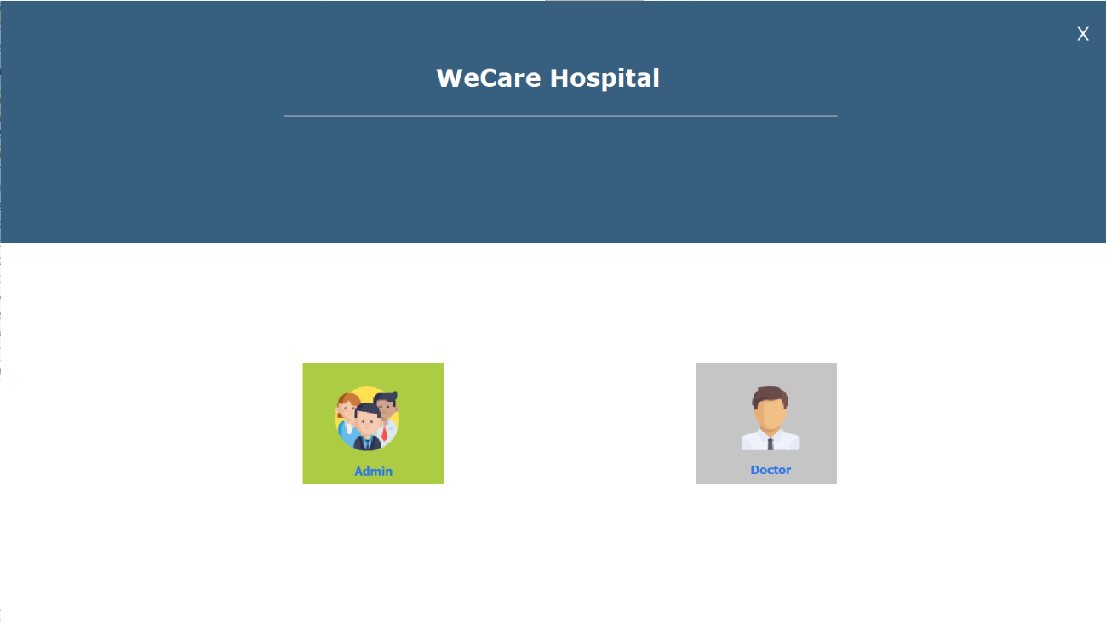
USER LOGIN PAGE

Slide 33
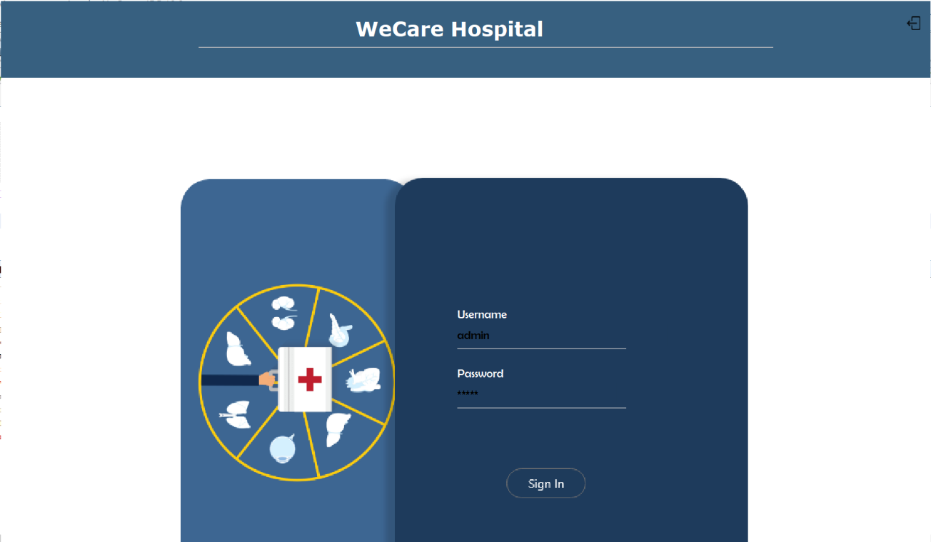
ENTER CREDENTIALS

Slide 34
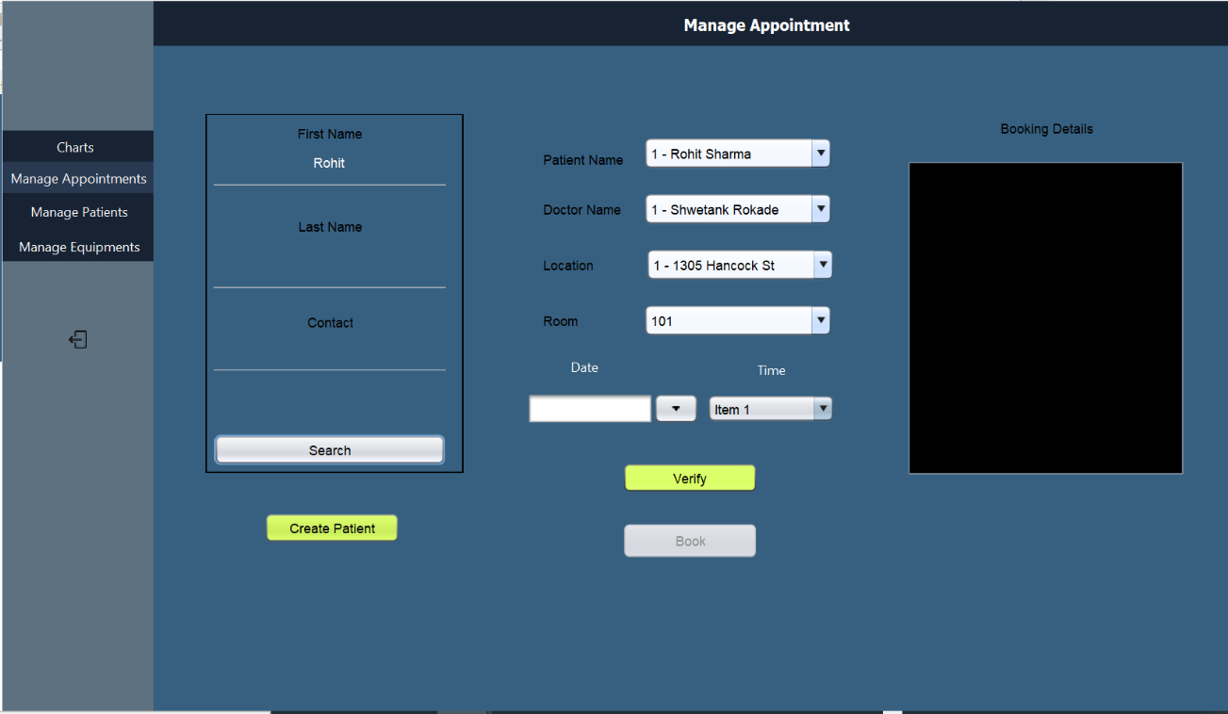
MANAGE APPOINTMENT

Slide 35
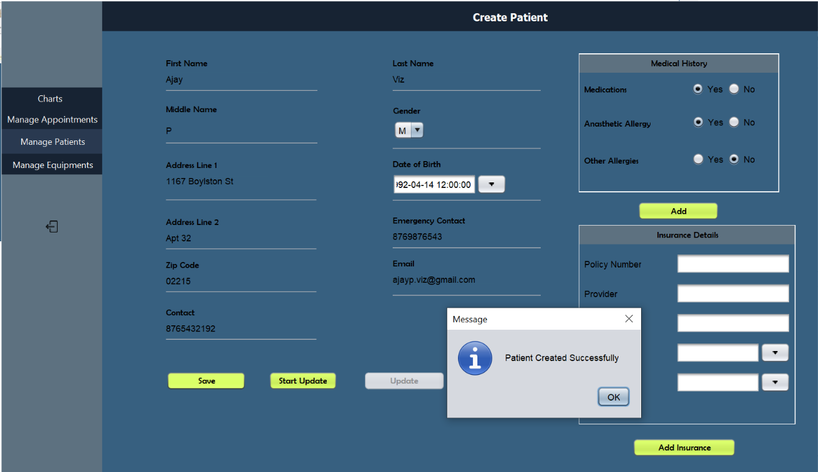
CREATE PATIENT

Slide 36
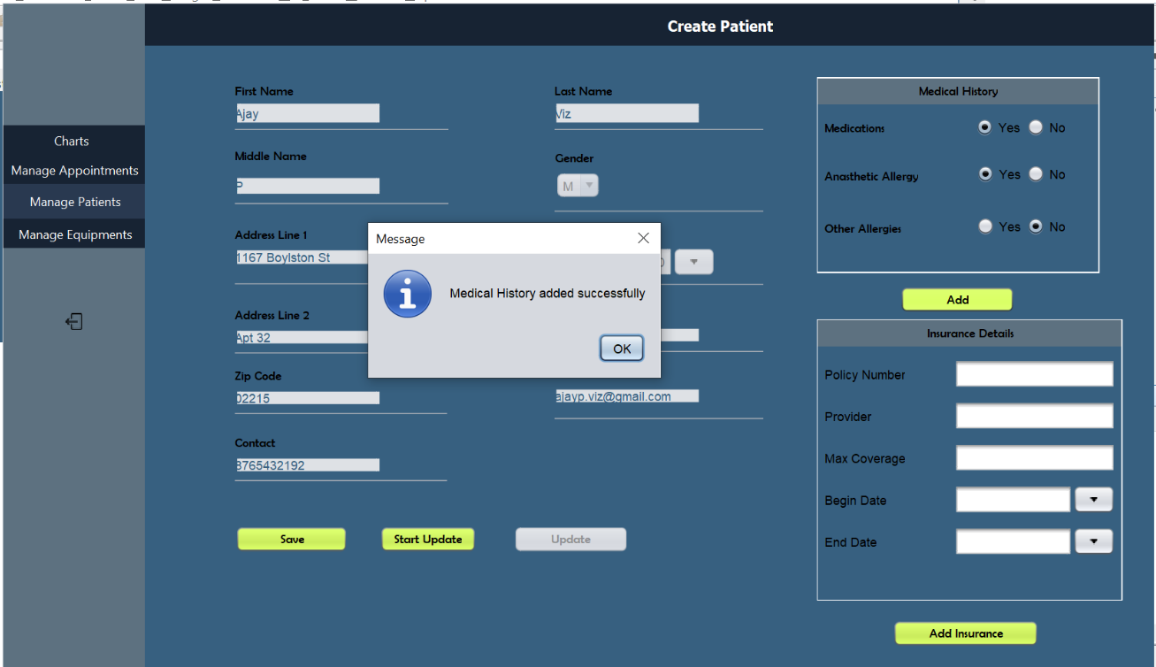
ADD MEDICAL HISTORY

Slide 37
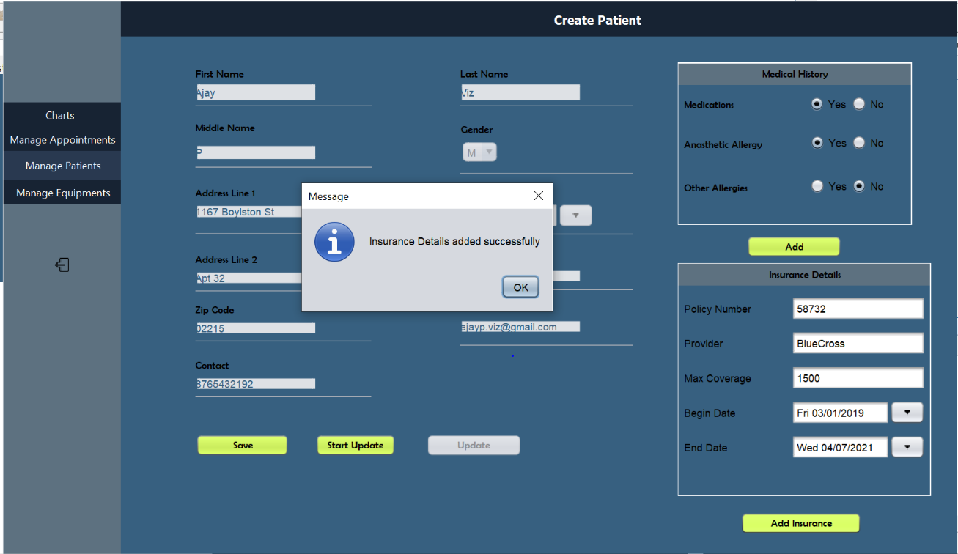
ADD INSUARANCE INFORMATION

Slide 38
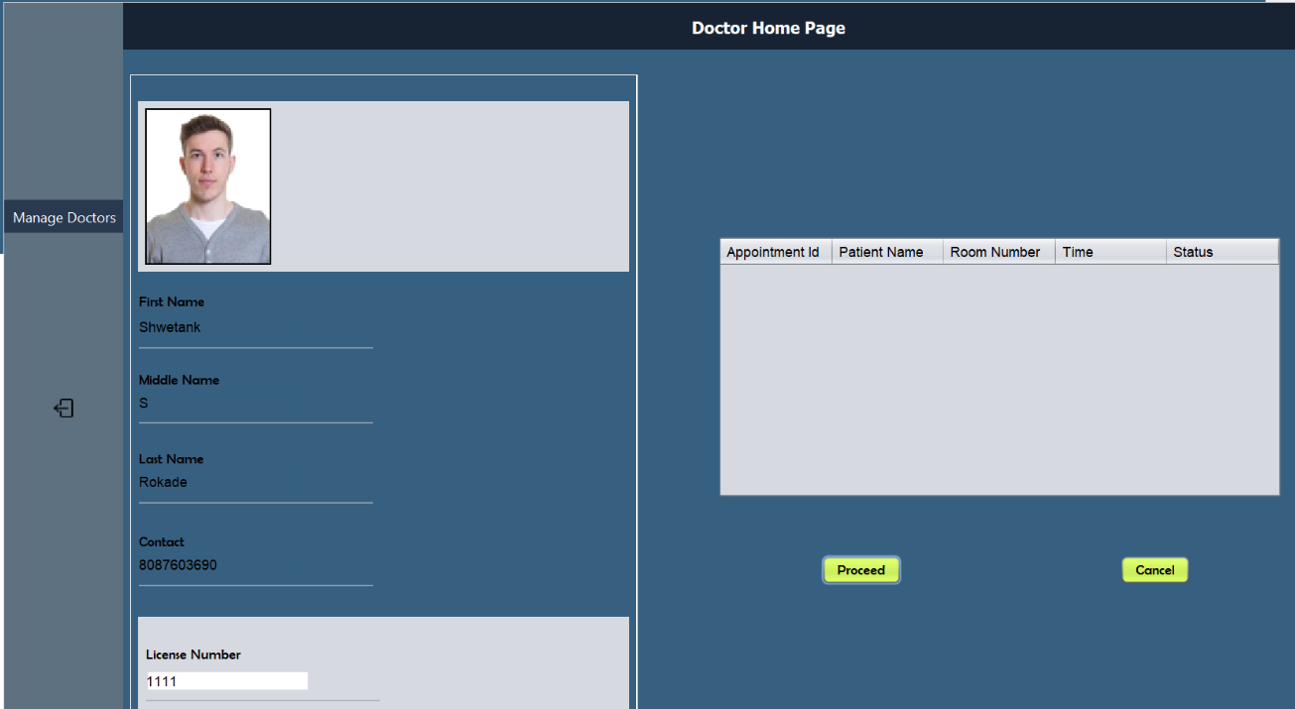
DOCTOR PANEL

Slide 39
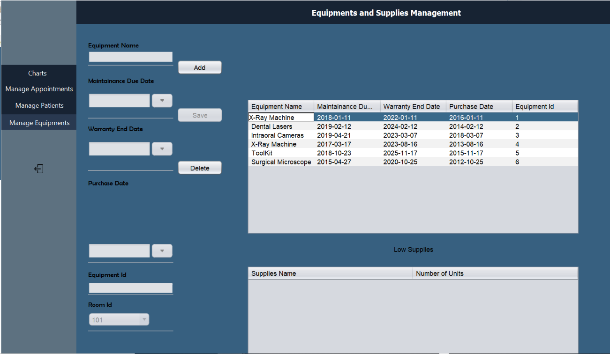
EQUIPMENT DETAILS

Slide 40
DASHBOARD

Slide 41
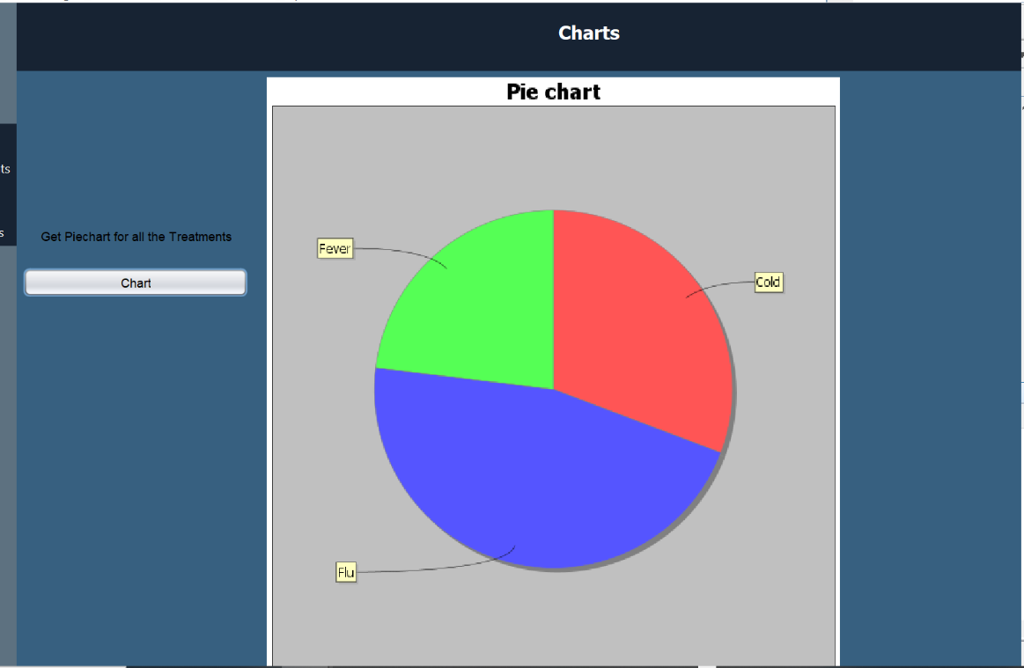

Slide 42


